Slide 1
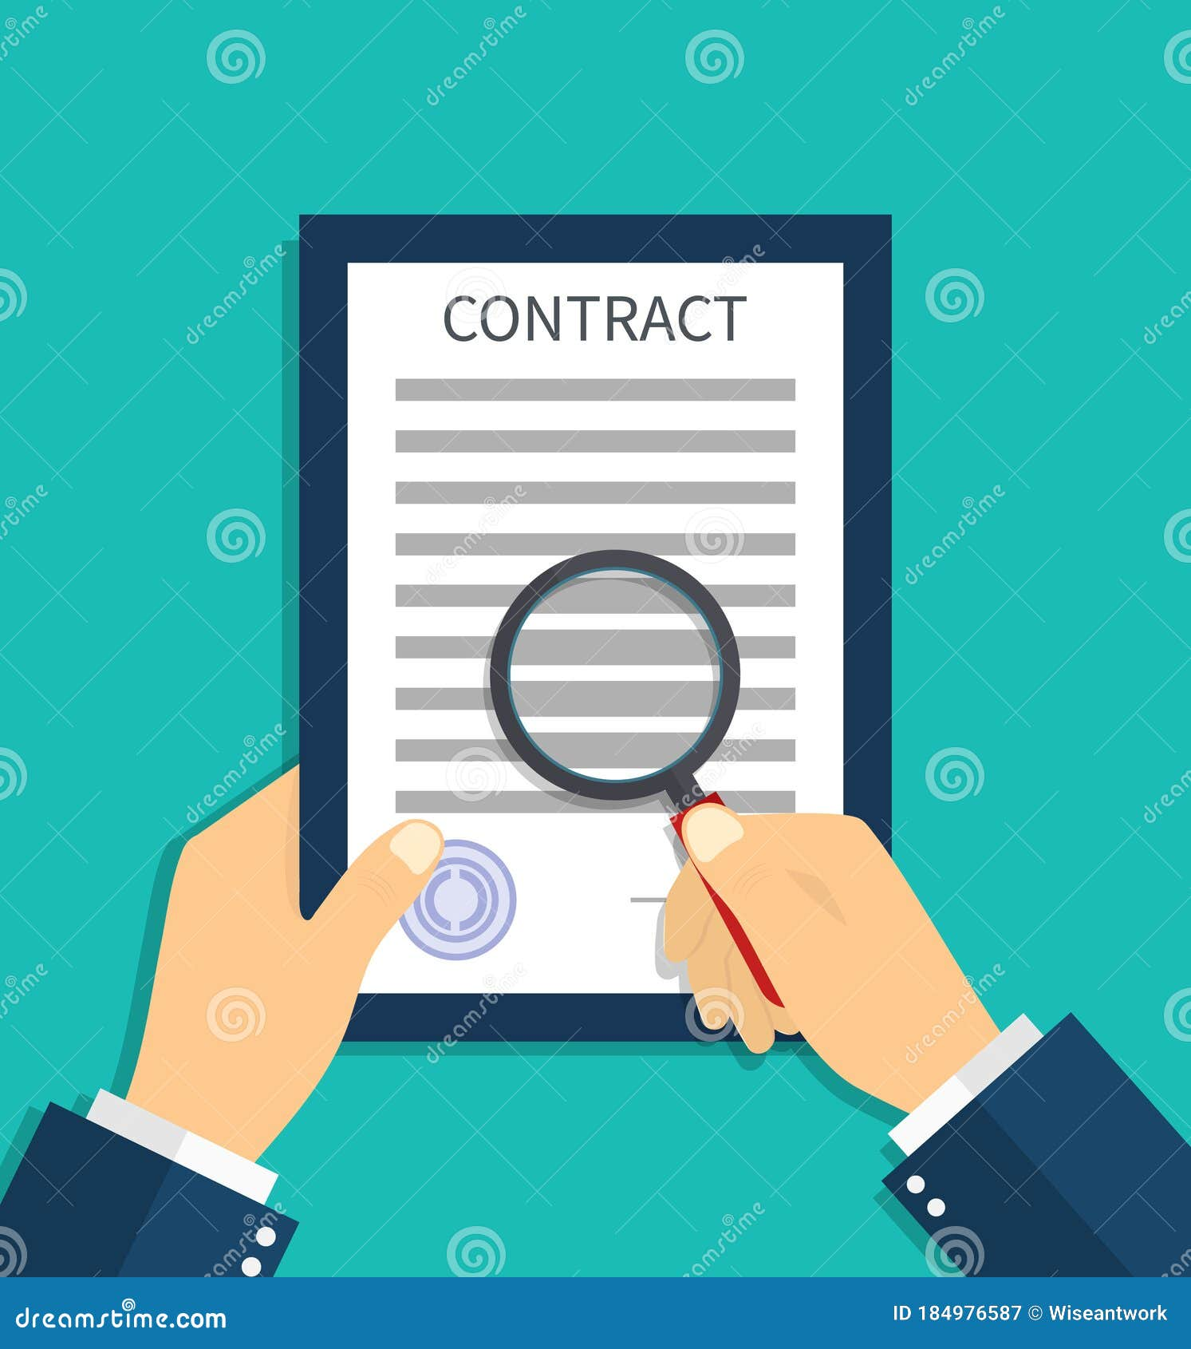


Contract Clause Evaluation
Musonda Sinkala
Project Bowery
Group 51

Slide 2

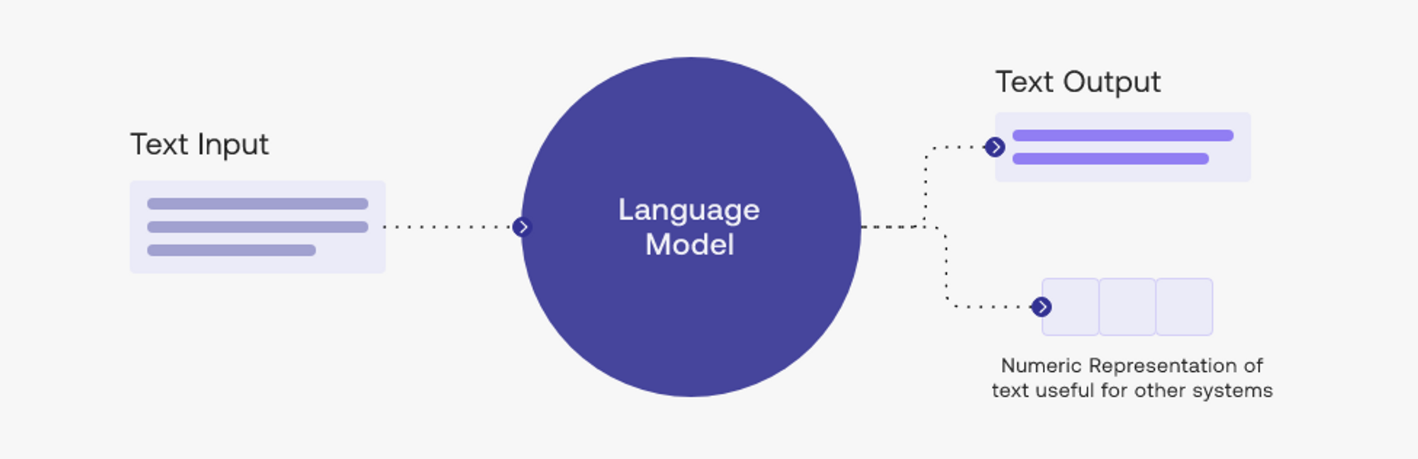



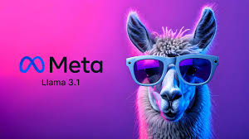
Research Question/Objective
Methodology: this will entail collecting a diverse dataset of relevant regulations and contracts across various types and jurisdictions, which will serve as the foundation for model testing and fine-tuning. We will leverage advanced language models, such as GPT-3 and Llama, to enhance the model's ability to classify and assess compliance within the contracts. By utilizing few-shot learning techniques, we aim to optimize the models with limited labeled data. Additionally, a user-friendly interface will be developed to facilitate interactions between users and the tool, allowing them to easily upload contracts, view model outputs, and provide feedback for ongoing refinement of the tool's performance.
Repository
Model
User Interface
Research Question: Can we effectively leverage Natural Language Processing to optimally ensure the protection of the second party to a contract? If so, how?
Contracts & Regulations

Slide 3
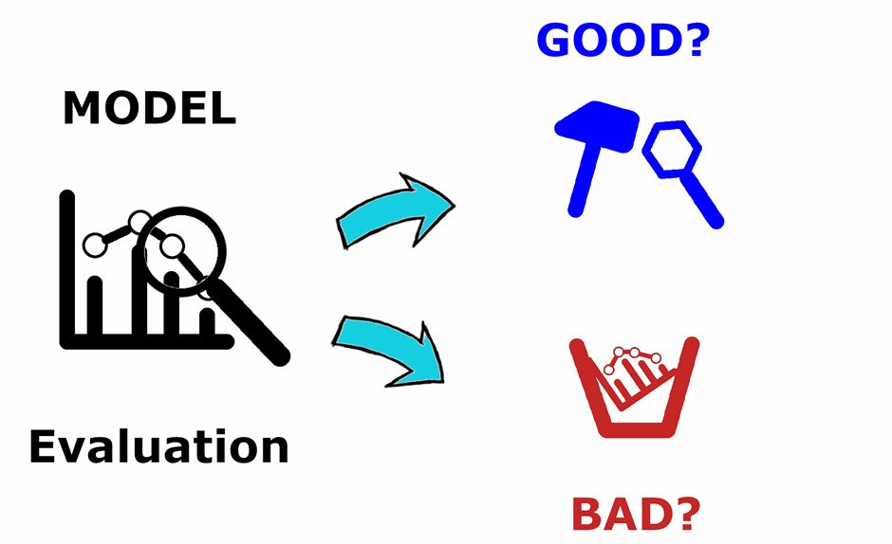


Planned Experiments/Tests
Initial experiments will entail assessing baseline language models to determine:
Extraction performance: how well they perform at extracting contractual clauses.
Flagging performance: how well they perform at flagging clauses unenforceable relative to a provided set of regulations.
Comparison of models: A comparative analysis will be conducted to evaluate the performance of different language models in flagging risky clauses, focusing on their ability to distinguish between enforceable and unenforceable clauses.
Assessing progress towards the research question will entail the following:
Flagging contract clauses into one of three classes: risky unenforceable, risky enforceable, enforceable.
Hence, with a robust dataset of such flagged clauses, model performance will be assessed by means of classification accuracy, precision and recall.
Input from individuals from NYU’s law department will provide qualitative assessments of the model's classifications, ensuring that the flagged clauses align with legal standards
Following this, the model will be fine-tuned and the experiments will be re-run.

Slide 4






Project Timeline
Progress
- Initial research and setup - Data Collection - Initial model testing - Preliminary observations
Weeks 1 - 2
Weeks 3 - 4
- Prompt refining (chain-of-thought reasoning) and continued model testing - With assistance from NYU’s law school, flag clauses as risky enforceable, risky unenforceable and enforceable
- Document common patterns in risky clauses to inform future model training and prompting strategies - Begin fine-tuning model
Week 5
Week 6
- Continue fine-tuning and evaluating model - Begin developing a mock/Initial User Interface
- Continue developing mock/Initial User Interface, leverage. - Begin report write up
Week 7
Finalize report and poster presentation

